Slide 1
Proposal for Potential Candidate Detection
Company XYZ
Yang Liu Kunz

Slide 2
TOC
Overview
Problem Identification
Dataset description
Data Wrangling
Key Findings
Modeling and Analysis
Summary and Recommendation
Appendix

Slide 3
Overview
The aim of this project is to use the credential/demographics/experience related data we collected from our training platform to find out the optimal solution to detect enrollees that are open for career change and connect them with our clients who are hiring.
KPI from the recruiting team: reach out to no less than 300 Target enrollees with minimum costs
The dataset we used for analysis contains information of 18,359 unique enrollees, among them 2425 enrollees were open for a career change. The ratio of Non-Target enrollees to Target enrollees is 6:1 (imbalanced data).
The best model enabled us to reach out to 515 Target enrollees with minimum costs.
In real business case we should have a clear KPI such as:
Reach: as many potential Target enrollees reached as possible (cost doesn’t matter)
Cost per Target: reach the most potential Target enrollees with the least financial cost
Here in this study we will aim for both

Slide 4
Dataset description
Data sources: Company XYZ training platform database
18,359 observations of 14 variables(4numerical, 10 categorical)
Input variables:
Experience related variables: experience, last_new_job, relevant_experience
Employer related variables: company_type, company_size
Education related variabels: education_level, major_discipline, enrolled_university
Gender: gender
City related variables: city (name), city_development_index(float)
Training related variables: training_hours(int)
Target(int): open for career change or not (0=no, 1=yes)
*enrollee_id(int) is excluded from input variables, variable city is already hashed in original dataset

Slide 5
Data Wrangling
Group | Variable Feature | Variable Names | Missing Value Percentage | Process Method
Group 1 | experience related variables | relevent_experience | 0 | data type correction
 |  | experience | 0.32 | data type correction, missing value imputation (fill with mode)
 |  | last_new_job | 2 | data type correction, missing value imputation (fill with mode)
Group 2 | employer related variables | company_type, | 27.45 | data grouping, missing value imputation (fill with KNN imputation) *KNN imputation will automatically convert the variable’s data type to float
 |  | company_size | 26.03 | data grouping, missing value imputation (fill with KNN imputation)
Group 3 | education related variables | education_level, | 2.49 | data grouping, data type correction, missing value imputation (fill with 0)
 |  | major_discipline | 15.46 | data grouping, data type correction, missing value imputation (fill with 0 or mode) *when education_level equals to 0 (None) or 1 (high school or primary school), fill missing value with 0, then fill the rest with 0
 |  | enrolled_university | 1.86 | fill with mode
Group 4 | gender | gender | 22.32 | data type correction, missing value imputation (fill with mode)
Group 5 | city related variables | city | - | data grouping, data type correction (dummy encoding)
 |  | city_development_index | - | -
Group 6 | training related variables | training_hours | - | -

Slide 6
Key Findings

Slide 7
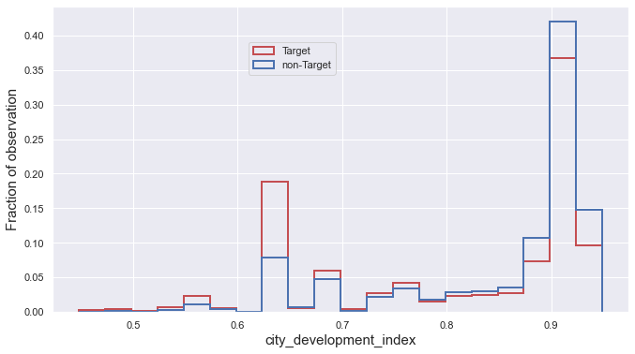
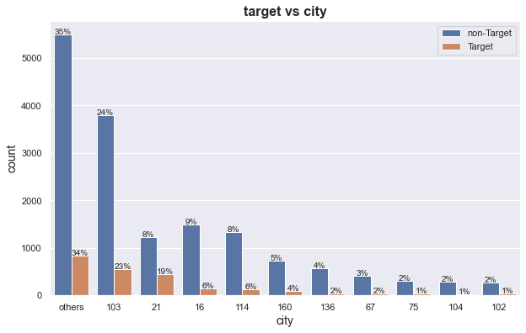
1 City vs. Target
Normalized histogram
City | city_development_index | Total enrollee | Target enrollee
103 | 0.920 | 4358 | 563
21 | 0.624 | 1672 | 453
16 | 0.910 | 1654 | 154
32% of the total enrollees, 30% of the Target enrollees are from cities where city_development_index ranges 0.910 ~ 0.920 (city 103, 16)
42% of the total enrollees, 48% of the Target enrollees are from city 103, 21, 16.

Slide 8
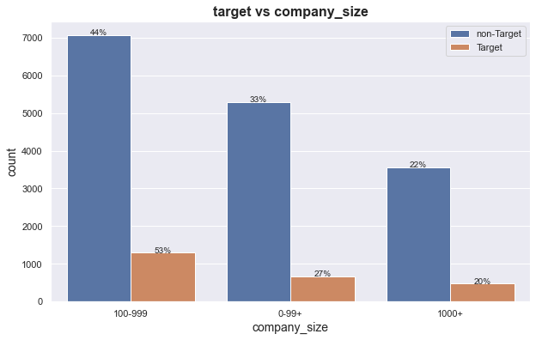
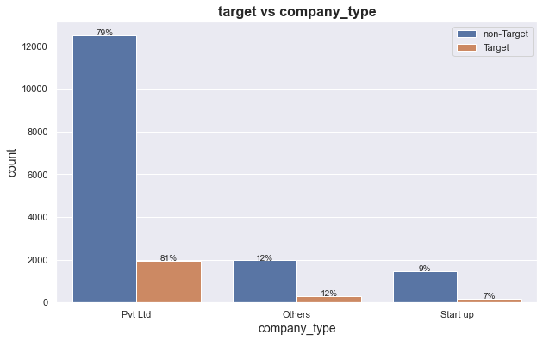
2 Employer vs. Target
46% of the total enrollees, 53% of Target enrollees are from medium size company (100~999)
79% of the total enrollees, 81% of the Target enrollees are from private limited company

Slide 9
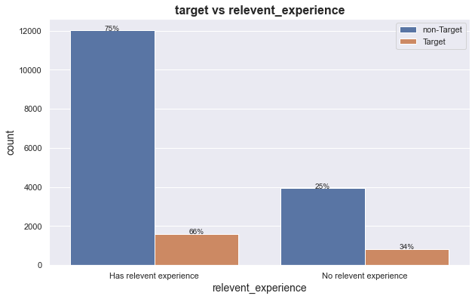
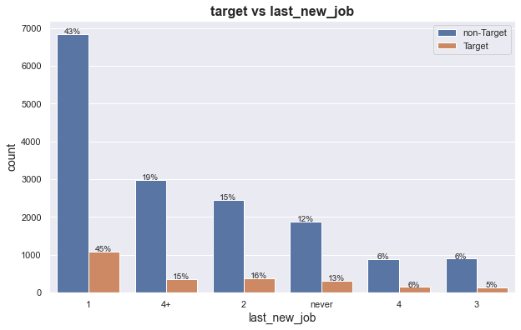
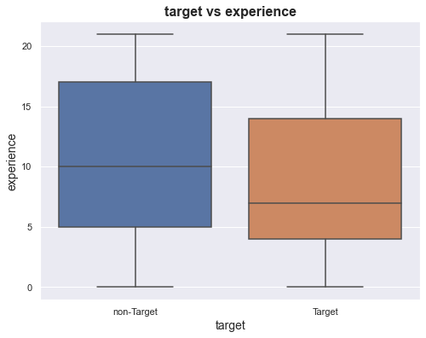
3 Experience vs. Target
66% of the Target enrollees has relevant experience in data science/analytics field
45% of the Target enrollees have stayed in their current company for 1 or less than 1 year. 15% of them have stayed in current company longer than 4 years.
non-Target enrollee compares to Target enrollee, has slightly longer average working years and wider range of working experience in years. (21 years means longer than 20 years)

Slide 10
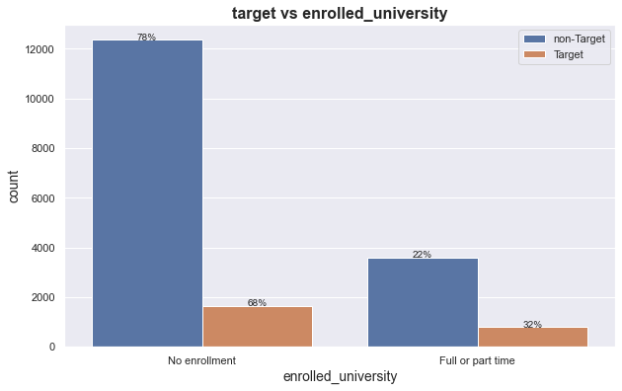
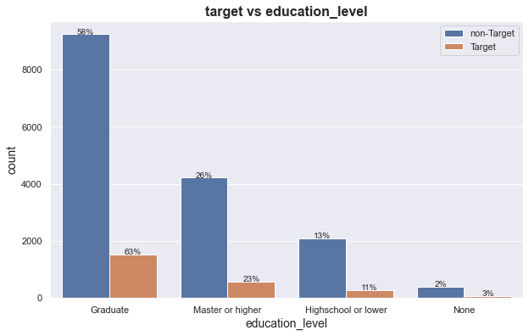
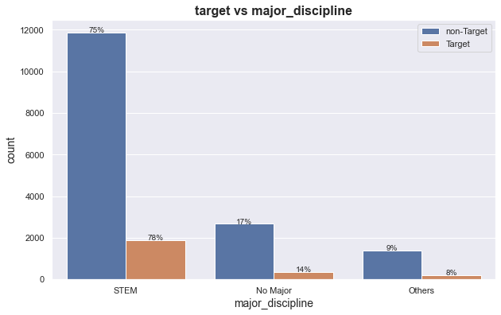
4 Education vs. Target
32% of the Target enrollees are enrolled in Full or part time university.
Graduate degree is the most common degree among all enrollees, 63% of the Target enrollees have a Graduate degree
Major STEM is the most common major among all enrollees, 78% of the Target enrollees have a STEM background

Slide 11
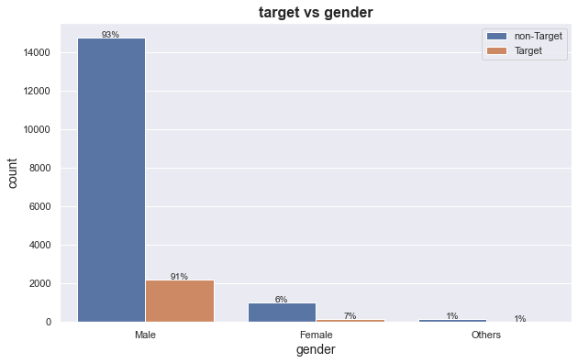
5 Gender vs. Target
Male is very dominant. 92% of the total enrollees are male
91% of the Target enrollees are male.

Slide 12
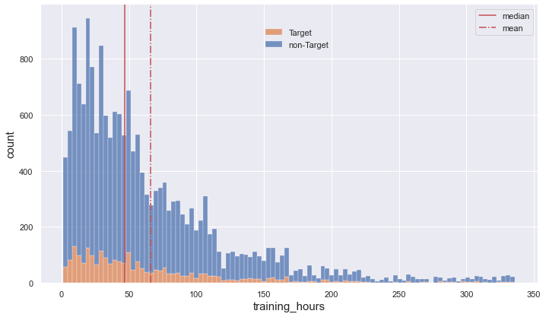
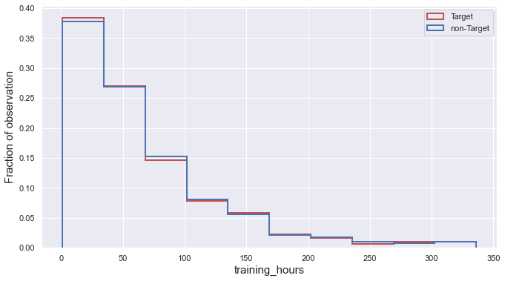
6 Training_hours vs. Target
Normalized histogram
Regardless of the class, the training time distribution is skewed right with a wide range of training time from 1 hour to 336 hours.
Two classes share lots of similarities in terms of summary statistic and distribution. The average training hours for Target and non-Target enrollee only has less than 1hour difference.

Slide 13
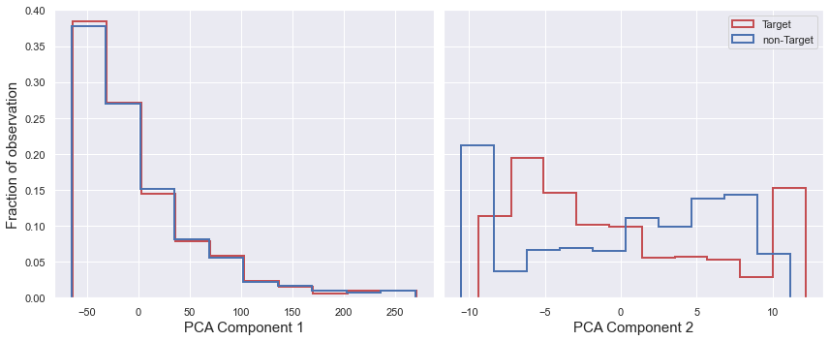
7 Feature Space Overlap
Converted categorical variables to numerical variables
Applied PCA reduction(2 components) to each class (enrollee_id excluded from variables)
Note lack of distinction in distribution and significant amounts of overlap between 2 classes
*histogram is normalized

Slide 14
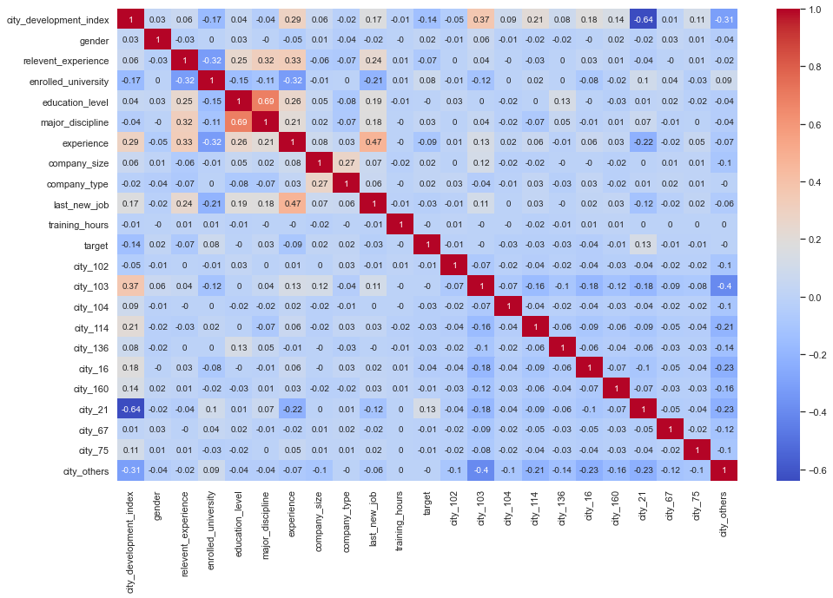
8 Multi
Multicollinearity
Variables are not highly correlated
As we dummy encoded variable city, therefore the correlation coefficient may not be statistically robust due to these binary values

Slide 15
Modeling and Analysis

Slide 16
Model Selection
Model Type | No. | Binary Classifier
Probabilistic Classifier | 1 | Logistic Regression
 | 2 | Gaussian Naïve Bayes
Instance-based Classifier | 3 | k-Nearest Neighbors
Support Vector Machine | 4 | Support Vector Machine
Tree Based Classifier | 5 | Decision Tree
 | 6 | Random Forest (Ensemble Bagging)
 | 7 | Gradient Boosting (Ensemble Boosting)
Optimized Gradient Boosting | 8 | XGBoost (Ensemble Boosting)
 | 9 | LightGBM (Ensemble Boosting)
 | 10 | CatBoost (Ensemble Boosting)
To gain better result, we explored 10 models with our dataset, identified the one with the best performance to be the final model.
You can find pros and cons for each model on this list from appendix

Slide 17
Train/Test Split
 | non-Target Count | Target Count | Target %
Full Dataset | 15,934 | 2,425 | 13.209
Training set | 11,154 (70%) | 1,697 | 13.205
Testing set | 4,780 (30%) | 728 | 13.217
Split data to Training/Testing set
Train 10 baseline models on Training set, apply 5Folds Cross Validation
Test models on Training set and Testing set

Slide 18
Metrics
Precision
Recall
F1score
ROC_AUC
Customized metrics:
Target in top 20%: the number of positive classes the model is able to catch within the top 20% of the test dataset when you sort the test dataset by their prediction scores (predicted probabilities) in descending order.
Target in top 50%: the number of the positive classes the model is able to catch within the top 50% of the dataset when you sort the test dataset by their prediction scores (predicted probabilities) in descending order.
*There are 728 positive classes (Target) in the Testing set

Slide 19
Best Model: Gradient Boosting
Training
Testing

Slide 20
Worst Model: Support Vector Machine
The result for other models can be found in Appendix
Training
Testing

Slide 21
Overall Model evaluation on Testing Set
Model | Precision | Recall | F1score | ROC_AUC | Target in top 20% | Target in top 50%
LR | 0 | 0 | 0 | 0.629 | 262 | 483
CatBoost | 0.244 | 0.014 | 0.026 | 0.630 | 261 | 482
GB | 0.286 | 0.003 | 0.005 | 0.645 | 259 | 493
GaussianNB | 0.230 | 0.337 | 0.274 | 0.608 | 251 | 458
LightGB | 0.333 | 0.016 | 0.031 | 0.618 | 237 | 473
XGB | 0.220 | 0.037 | 0.063 | 0.599 | 225 | 456
RF | 0.270 | 0.051 | 0.086 | 0.594 | 211 | 456
KNN | 0.210 | 0.041 | 0.069 | 0.550 | 189 | 413
DT | 0.179 | 0.220 | 0.197 | 0.533 | 186 | 391
SVC | 0 | 0 | 0 | 0.507 | 152 | 364
As we expect the model to capture as many Target enrollees as possible from the Testing set, therefore instead of accuracy, we need to focus on the Recall score.
However as we can see most of the models have poor Recall due to the class imbalance issue in the dataset.
Therefore we tried to improve the model performance by oversampling

Slide 22
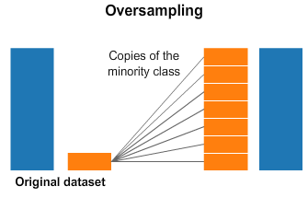
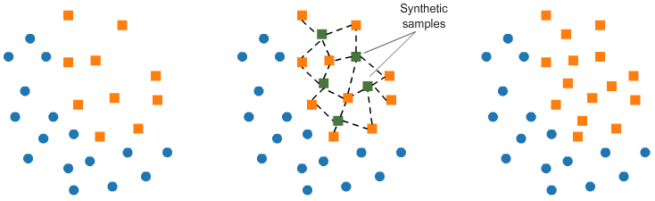
Synthetic Minority Oversampling Technique (SMOTE)
Example of SMOTE find 4 nearest neighbors

Slide 23
Overall Model evaluation on Testing Set (after SMOTE)
Change in percentage after SMOTE
Model | Precision | Recall | F1score | ROC_AUC | Target in top 20% | Target in top 50%
LR | 0.192 | 0.521 | 0.281 | 0.623 | 253 | 480
GaussianNB | 0.151 | 0.674 | 0.246 | 0.598 | 251 | 441
KNN | 0.144 | 0.455 | 0.218 | 0.541 | 182 | 391
SVC | 0.153 | 0.647 | 0.247 | 0.58 | 212 | 440
DT | 0.162 | 0.195 | 0.177 | 0.52 | 171 | 387
RF | 0.237 | 0.065 | 0.102 | 0.588 | 206 | 450
GB | 0.381 | 0.033 | 0.061 | 0.633 | 260 | 475
XGB | 0.257 | 0.038 | 0.067 | 0.6 | 215 | 450
LightGB | 0.309 | 0.029 | 0.053 | 0.628 | 236 | 484
CatBoost | 0.315 | 0.04 | 0.071 | 0.623 | 247 | 481
Model | Precision | Recall | F1score | ROC_AUC | Target in top 20% | Target in top 50%
LR | ∞ | ∞ | ∞ | -0.95 | -3.44 | -0.62
GaussianNB | -34.35 | 100.00 | -10.22 | -1.64 | 0.00 | -3.71
KNN | -31.43 | 1009.76 | 215.94 | -1.64 | -3.70 | -5.33
SVC | ∞ | ∞ | ∞ | 14.40 | 39.47 | 20.88
DT | -9.50 | -11.36 | -10.15 | -2.44 | -8.06 | -1.02
RF | -12.22 | 27.45 | 18.60 | -1.01 | -2.37 | -1.32
GB | 33.22 | 1000.00 | 1120.00 | -1.86 | 0.39 | -3.65
XGB | 16.82 | 2.70 | 6.35 | 0.17 | -4.44 | -1.32
LightGB | -7.21 | 81.25 | 70.97 | 1.62 | -0.42 | 2.33
CatBoost | 29.10 | 185.71 | 173.08 | -1.11 | -5.36 | -0.21
Before SMOTE Target in top 20% | After SMOTE Target in top 20% |  | Before SMOTE Target in top 50% | After SMOTE Target in top 50%
262 (LR) | 260 (GB) |  | 493 (GB) | 480 (LR)
261 (CatBoost) | 253 (LR) |  | 483 (LR) | 475 (GB)
259 (GB) | 251 (GNB) |  | 482 (CatBoost) | 441 (GNB)

Slide 24
Key Metrics: which one is the key metrics
Hypothesis 1: Recall is the key metrics
Best Recall: 0.674
Best model: GaussianNB after SMOTE
Confusion matrix:
 | Predicted Target | Predicted non-Target
Target | TP: 491 | FN:237
non-Target | FP: 2770 | TN: 2010
1) KPI for recruiting team:
reach out to no less than 300 Target enrollees with minimum costs
2) Conclusion:
Target in top 50%
is the key metrics for model comparison
Potential Targets approach list: 491+2770 = 3261
Cost per email sent: $1
Cost Per Target: 3261*1/491 = $6.6
Hypothesis 2: Targets in top 50% is the key metrics
Best Target in top 50%: 493
Best model: Gradient Boosting before SMOTE
Potential Targets approach list: 50% of the Testing set, 5508*0.5 = 2754
Cost per email sent: $1
Cost per Target: 2754/493 = $5.6

Slide 25
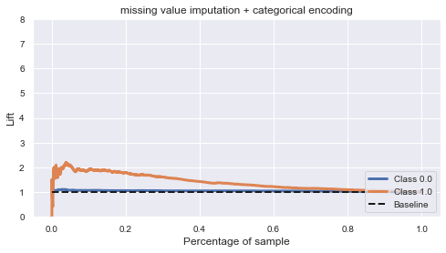
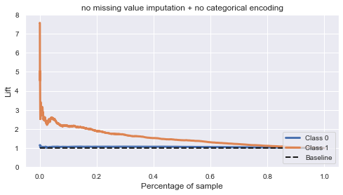
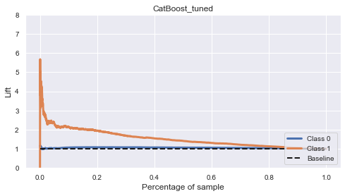
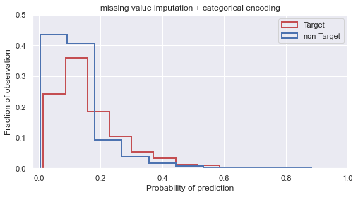
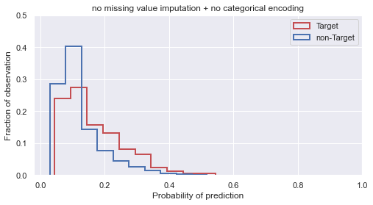
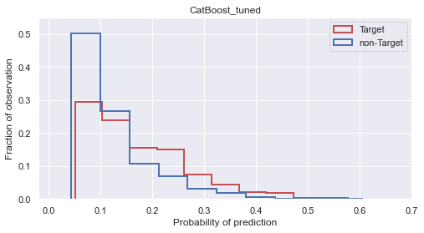
Experiment: CatBoost handles missing values and categorical variables
CatBoost | Precision | Recall | F1score | ROC_AUC | Target in top 20% | Target% in top 20% | Target in top 50% | Target% in top 50%
Data processed | 0.244 | 0.014 | 0.026 | 0.630 | 261 | 35.9% | 482 | 66.2%
Data Not processed (baseline model) | 0.500 | 0.005 | 0.011 | 0.662 | 275 | 37.8% | 514 | 70.6%
Hyperparameter tuned | 0.571 | 0.005 | 0.011 | 0.664 | 283 | 38.9% | 515 | 70.7%
we applied hyperparameter tuning via random search Cross Validation (3 Folds) to the model and obtained our optimized model

Slide 26
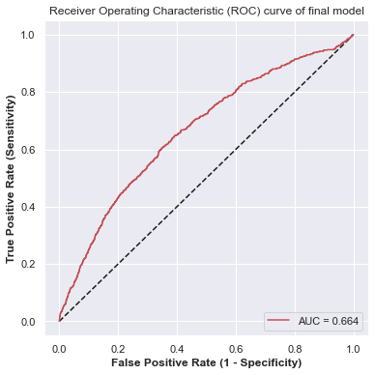
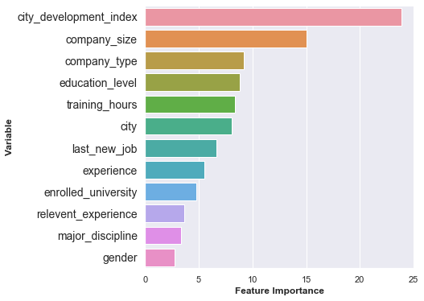
Final Model model_final = CatBoostClassifier(iterations=988, depth=2, learning_rate=0.07165)

Slide 27
Summary and Recommendation
Imbalanced data and feature overlap problem posed difficulties in model training. Resulted in low Recall and low Precision cross all models.
When Recall and Precision are not ideal, we can use customized metrics like Targets captured in top 50% to achieve the KPI Target.
To solve the high degree of feature overlap between the two classes in this dataset, a good solution is to add more features/variables in the dataset if possible. Features like age, income and job title/level information.

Slide 28
Appendix

Slide 29
Model pros and cons
No. | Binary Classifier | Advantages | Disadvantages
1 | Logistic Regression | East to interpret Small number of hyperparameters Overfitting can be addressed though regularization | May overfit when provided with large numbers of features Can only learn linear hypothesis functions Input data might need scaling May not handle irrelevant features well
2 | Gaussian Naïve Bayes | No training involved Very little parameter tuning is required Features do not need scaling | Assumes that the features are independent, which is rarely true
3 | k-Nearest Neighbors | No training involved, easy to implement Only one hyperparameter | Need to find optimal number of K Slow to predict Outlier sensitivity
4 | Support Vector Machine | Accuracy Works well on smaller cleaner datasets Is effective when umber of dimensions is greater than the number of samples. | Isn’t suited to larger datasets as the training time can be high Less effective on noisier datasets with overlapping classes
5 | Decision Tree | Easy to interpret Work with numerical and categorical features. Requires little data preprocessing Performs well on large datasets Doesn’t require normalization | Overfitting Unable to predict continuous values Doesn’t work well with lots of features and complex large dataset
6 | Random Forest (Ensemble Bagging) | Excellent predictive power Requires little data preprocessing Doesn’t require normalization Suitable for large dataset Plenty of optimization options | Overfitting risk Parameter complexity Limited with regression
7 | Gradient Boosting (Ensemble Boosting) | Excellent predictive accuracy Can optimize on different loss functions Provides several hyperparameter tuning options that make the function fit very flexible. | Overfitting risk Computationally expensive Parameter complexity
8 | XGBoost (Ensemble Boosting) | Regularization to prevent overfitting Computational efficiency and often better model performance Can handle missing value | Difficult to interpret and visualize Parameter complexity Time consuming when dataset is large
9 | LightGBM (Ensemble Boosting) | High speed, high accuracy Can handle missing value and categorical value Low memory usage Compatibility with large dataset | Parameter complexity Overfitting risk
10 | CatBoost (Ensemble Boosting) | Can handle missing value and categorical value Work well with both small and large dataset Can monitor loss function | Prevent overfitting Normally doesn’t need to tune hyperparameters to gain better result

Slide 30
Logistic Regression: Training vs Testing
Training
Testing
$cumulative lift \left(0.2\right)= \frac{\% of positive classes in all deciles up to dec}{\% of positive classes in testing set}$ = $\frac{262/1102}{ 0.132}$ ≈ 1.80

Slide 31
Gaussian Naïve Bayes : Training vs Testing
Training
Testing

Slide 32
k-Nearest Neighbors : Training vs Testing
Training
Testing

Slide 33
Decision Tree: Training vs Testing
Training
Testing

Slide 34
Random Forest: Training vs Testing
Training
Testing

Slide 35
XGBoost: Training vs Testing
Training
Testing

Slide 36
LightGB: Training vs Testing
Training
Testing

Slide 37
CatBoost: Training vs Testing
Training
Testing

Slide 38
Hyperparameter Tuning for CatBoost
1) Parameter Range:
parameters = {'depth' : sp_randInt(1, 5),
'learning_rate' : sp_randFloat(),
'iterations' : sp_randInt(800, 1100)}
2) Tuned result:
parameters = {'depth’ : 2,
'learning_rate’ : 0.072
'iterations’ : 988}

Slide 39
Link for dataset
https://www.kaggle.com/aswathrao/hr-analysis?select=train.csv

